Slide 1

Healthcare Domain Analysis
Project Members:
Sravya Raghupatruni
Sadhna Kumari
Hanumant Gavali
Sahil Sawant

Slide 2
Content
Key Performance Indicator
Project Architecture
Project Schema
SQL Work
Excel Dashboard
Tableau Dashboard
PowerBI Dashboard
Conclusion

Slide 3
Key Performance Indicator
Country wise Food Instruments Stats
Average Cost trend with respect to year
Country wise WIC Card Transaction Stats
Percentage of Participants redeemed as per category
Relationship between Total Cost Voucher Vs Number of Families Redeemed Food Benefits

Slide 4
Project Architecture:
7.Dashboard Visualization
1.Data Source
PROJECT ARCHITECTURE
6.Insights
2.Data collection
5.Building Reports
3.ETL process
4.Schema building

Slide 5
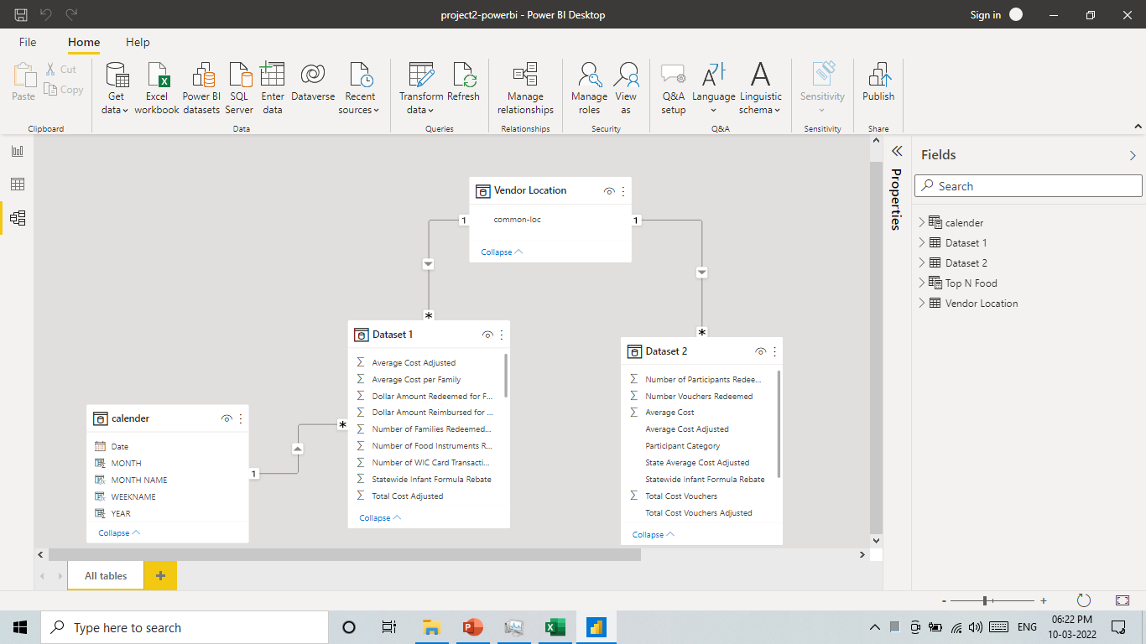
Project Schema: Partial Star Schema

Slide 6
SQL Work
KPI 1: No of Food Instruments Redeemed by Vendor Location
select `Vendor Location`,
sum(`Number of Food Instruments Redeemed`) Number_of_Food_Instruments_Redeemed
from ds1
group by `Vendor Location`
order by Number_of_Food_Instruments_Redeemed desc;
KPI 2: No. of WIC Card Transactions Processed by Vandor Country
select `Vendor Location`,sum(`Number of WIC Card Transactions Processed`)
from ds1
group by `Vendor Location`
order by sum(`Number of WIC Card Transactions Processed`) desc;
KPI 3: Avg Cost per Family by Year
select `Obligation Year and Month`,
format(sum(`Average Cost per Family`),2) `Average Cost per Family`
from ds1
group by `Obligation Year and Month`
order by `Obligation Year and Month` asc;
KPI 5: Total Cost Voucher vs No. of Families Redeemed Food Benefits
select `Vendor Location`,
format(sum(`Number of Families Redeemed Food Benefits`),"0"),
format(sum(`Total Cost Vouchers`),"2") from ds1
join ds2
using (`Vendor Location`)
group by `Vendor Location`
order by `Vendor Location` desc;
KPI 4: No. of Participants Redeemed by Participant Category
select `Participant Category`,
format(((sum(`Number of Participants Redeemed`)*100)/
(select sum(`Number of Participants Redeemed`) from ds2)),"2") `% of Total`
from ds2
group by `Participant Category`
order by sum(`Number of Participants Redeemed`) desc;

Slide 7
EXCEL DASHBOARD
No. food instruments & the amount of food ins. redeemed by State-wide.
Lowest food instruments redeemed by Sierra.
Average -4.35M
Trend for WIC card transaction is inclining.
State-wide processed higher number of WIC card transactions.
Average transactions-1.9M
Average cost trend is declining.
Decline in Food inst and WIC transactions is observed.

Slide 8
Child category has higher (54%) among No of participant redeemed.
Child category has declining trend, while the remaining categories are in constant trend.
Total cost vouchers and No of families redeemed are directly proportional.
Statewide and Los Angels are ranking top, respectively.
Total cost vouchers -22k app.

Slide 9
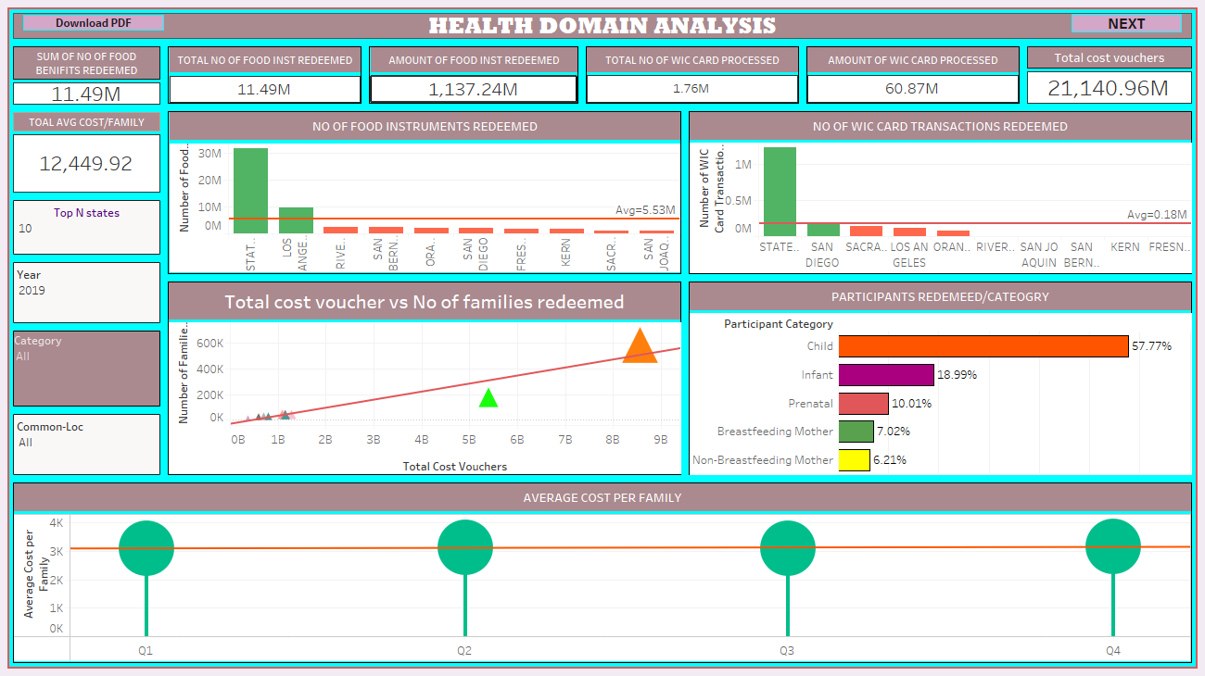
TABLEAU DASHBOARD

Slide 10
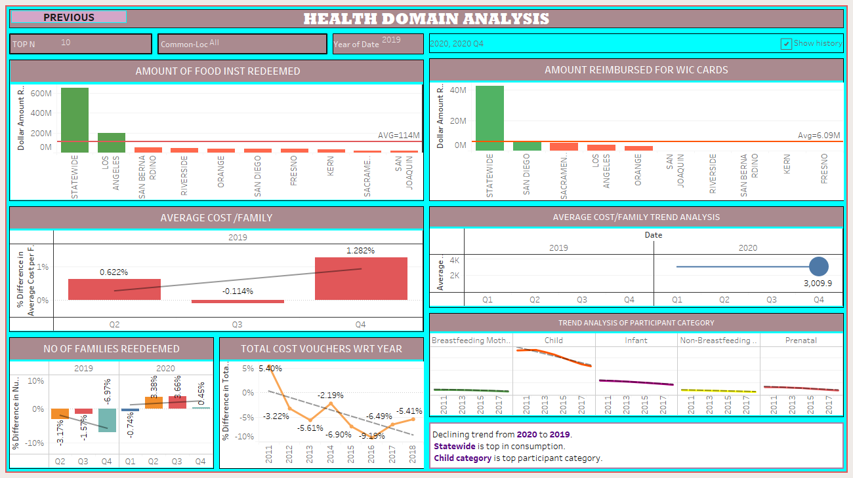

Slide 11
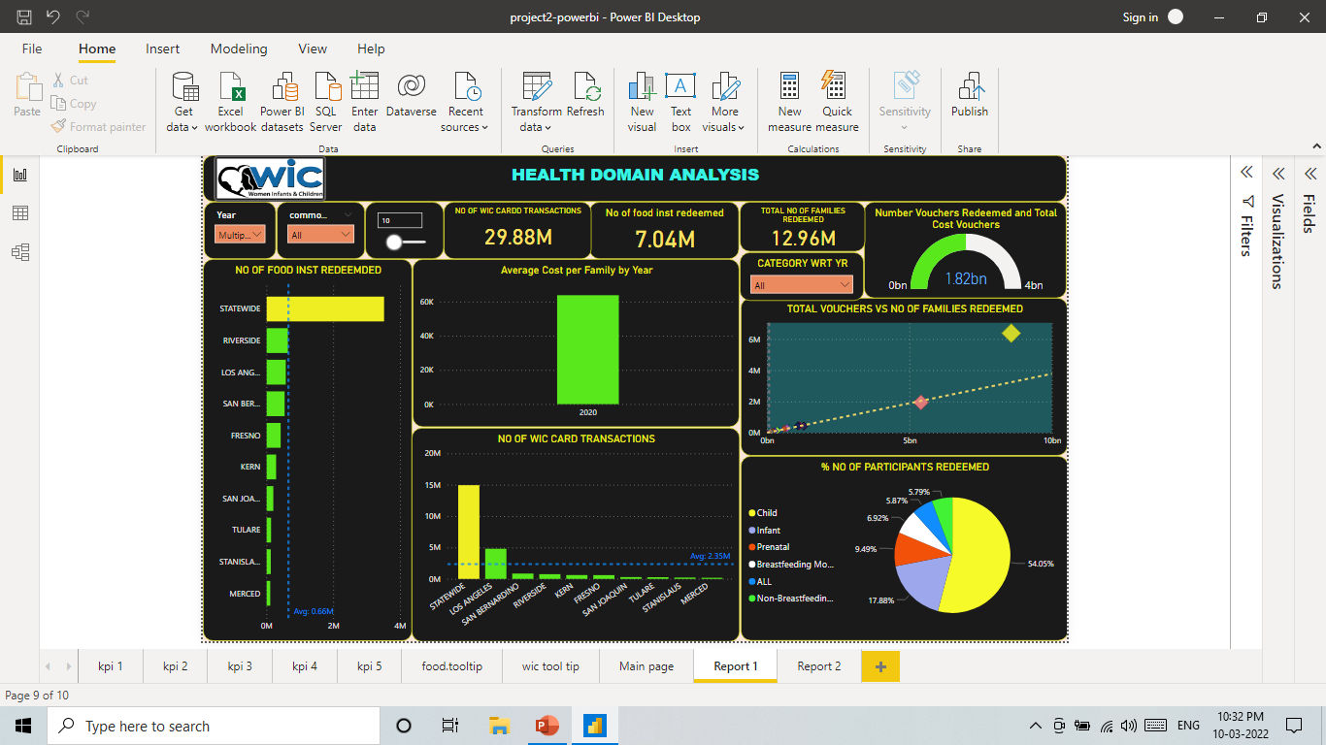
Report 1
POWERBI DASHBOARD
Notes:
LOCATION
No alt text provided
slicer
No alt text provided
NO OF FOOD INST REDEEMDED
No alt text provided
No of food inst redeemed
No alt text provided
clusteredColumnChart
No alt text provided
NO OF WIC CARD TRANSACTIONS
No alt text provided
NO OF WIC CARDD TRANSACTIONS
No alt text provided
textbox
No alt text provided
% NO OF PARTICIPANTS REDEEMED
No alt text provided
TOTAL VOUCHERS VS NO OF FAMILIES REDEEMED
No alt text provided
gauge
No alt text provided
TOTAL NO OF FAMILIES REDEEMED
No alt text provided
CATEGORY WRT YR
No alt text provided
slicer
No alt text provided
image
No alt text provided
actionButton
No alt text provided

Slide 12
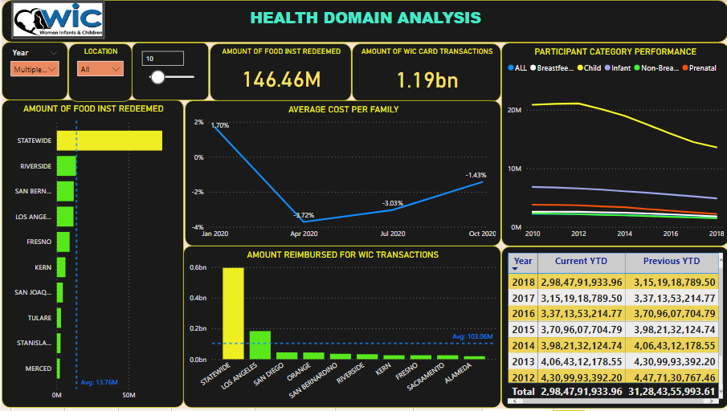
Report 2
Notes:
AMOUNT OF FOOD INST REDEEMED
No alt text provided
AMOUNT OF FOOD INST REDEEMED
No alt text provided
AMOUNT REIMBURSED FOR WIC TRANSACTIONS
No alt text provided
AMOUNT OF WIC CARD TRANSACTIONS
No alt text provided
PARTICIPANT CATEGORY PERFORMANCE
No alt text provided
tableEx
No alt text provided
slicer
No alt text provided
slicer
No alt text provided
LOCATION
No alt text provided
slicer
No alt text provided
AVERAGE COST PER FAMILY
No alt text provided
slicer
No alt text provided
slicer
No alt text provided
textbox
No alt text provided
image
No alt text provided
actionButton
No alt text provided

Slide 13
Conclusion
Statewide is top among all the County.
Child category has declining trend, however it is ranking top.
Trend is declining from 2020 to 2021
Sierra is the standing at the bottom.
More than 75% of the counties are falling below the average line.
Total Cost Voucher vs No. of Families Redeemed Food Benefits are proportional.

Slide 14
Thank You…!!

